Slide 1
Prototype 1
Khac Minh Dai Vo, September 10, 2023
Included Notice (persona, storyboard), Empathize (Empathy/Journey Map), Define (Mad Lib PoVs), Ideate (brainstorm, saturate, group, select), Prototype (front end 3-mobile-screen-sketch, backend in PT), Test, Reflect and Iterate.

Slide 2
Overall Design Process
Notice/Empathize
Persona
Henry Chamber, MD-Hospitalist that covering the hospital census with three other physicians.
6-panel Storyboard of His Day to empathize with his job and concern.
Do a combined Interview for Empathy/Journey Map of Her Day, showing the ups and downs of her emotions during different activities.
Chapter 7 in the “Enabling the Internet of Things” Text, especially the summary table on p. 148 of the PDF
Problem is job included fatigue from repetitive, monotonous tasks and frequent need to respond to multiple urgent matters at the same time. Patient’s summary facing information overload and not able to confirm the patient’s past medical history. Entering information into EHR can distract from interactions with patients.
Possible solutions: Comprehensive patient history access including procedures and diagnoses from the last 3 years with speed; Patient post-release tracking to help minitor how patients feel after each discharge; Automatic patient alerts within the EHR to notify appropriate staff for new admitted patients in order to support patient assessment and treatment in reasonable time manner; Mobile EHR applications on smartphone, ipad to in order to help access the patient information quickly.
IoT application areas: Smart hospital services, remote patient monitoring, remote diagnostics and examinations, medical record management, remote caregiver assistance, mobile assistance.
I will choose Healthcare and Well-being as areas from Chapter 7 that might help with Henry through certain parts of his day.
Desire
Converging
Write 2 effective PoV Madlibs
Ideate
Diverging
Brainstorm(show >= 20 ideas upgroupd)
Group (on a different slide show ideas grouped into 3 or more clusters)
Converging
Select(and fill out the “From Divergent to Convergent” Slide)
Prototype: Build a Lo-fidelity prototype
Do 3 screen mock-up of the experience ON PAPER (system front end)
Place and connect some devices IN PACKET TRACER (system back end) - model does not have to work yet.
Test With Users, Reflect, and Plan for the Next Iteration (back to Notice/Empathize Again) Description.

Slide 3
Notice/Empathize

Slide 4
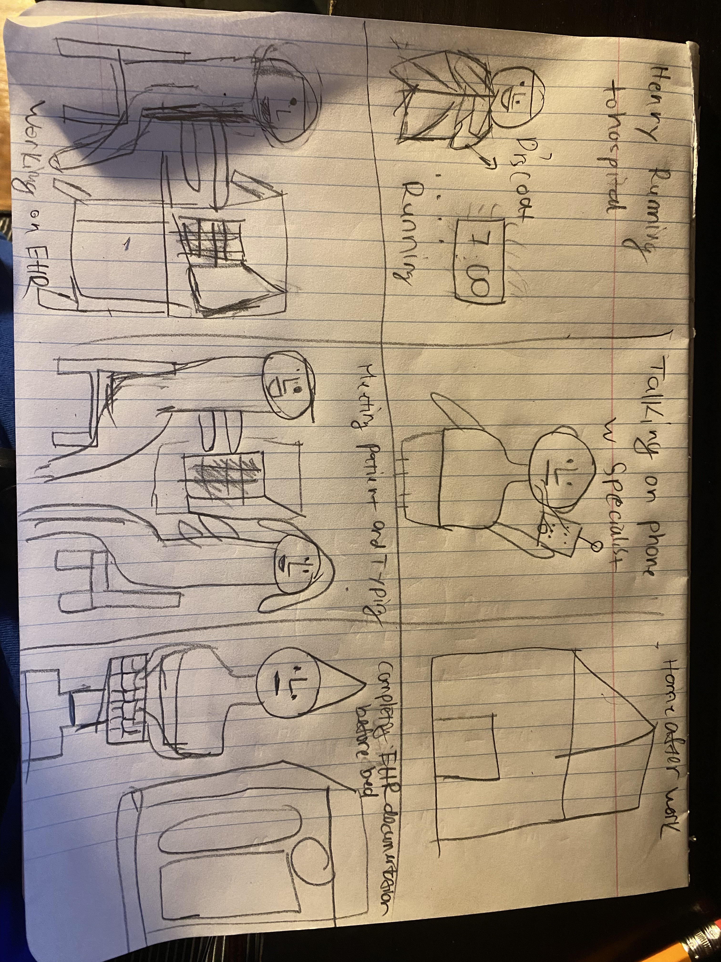


Slide 5
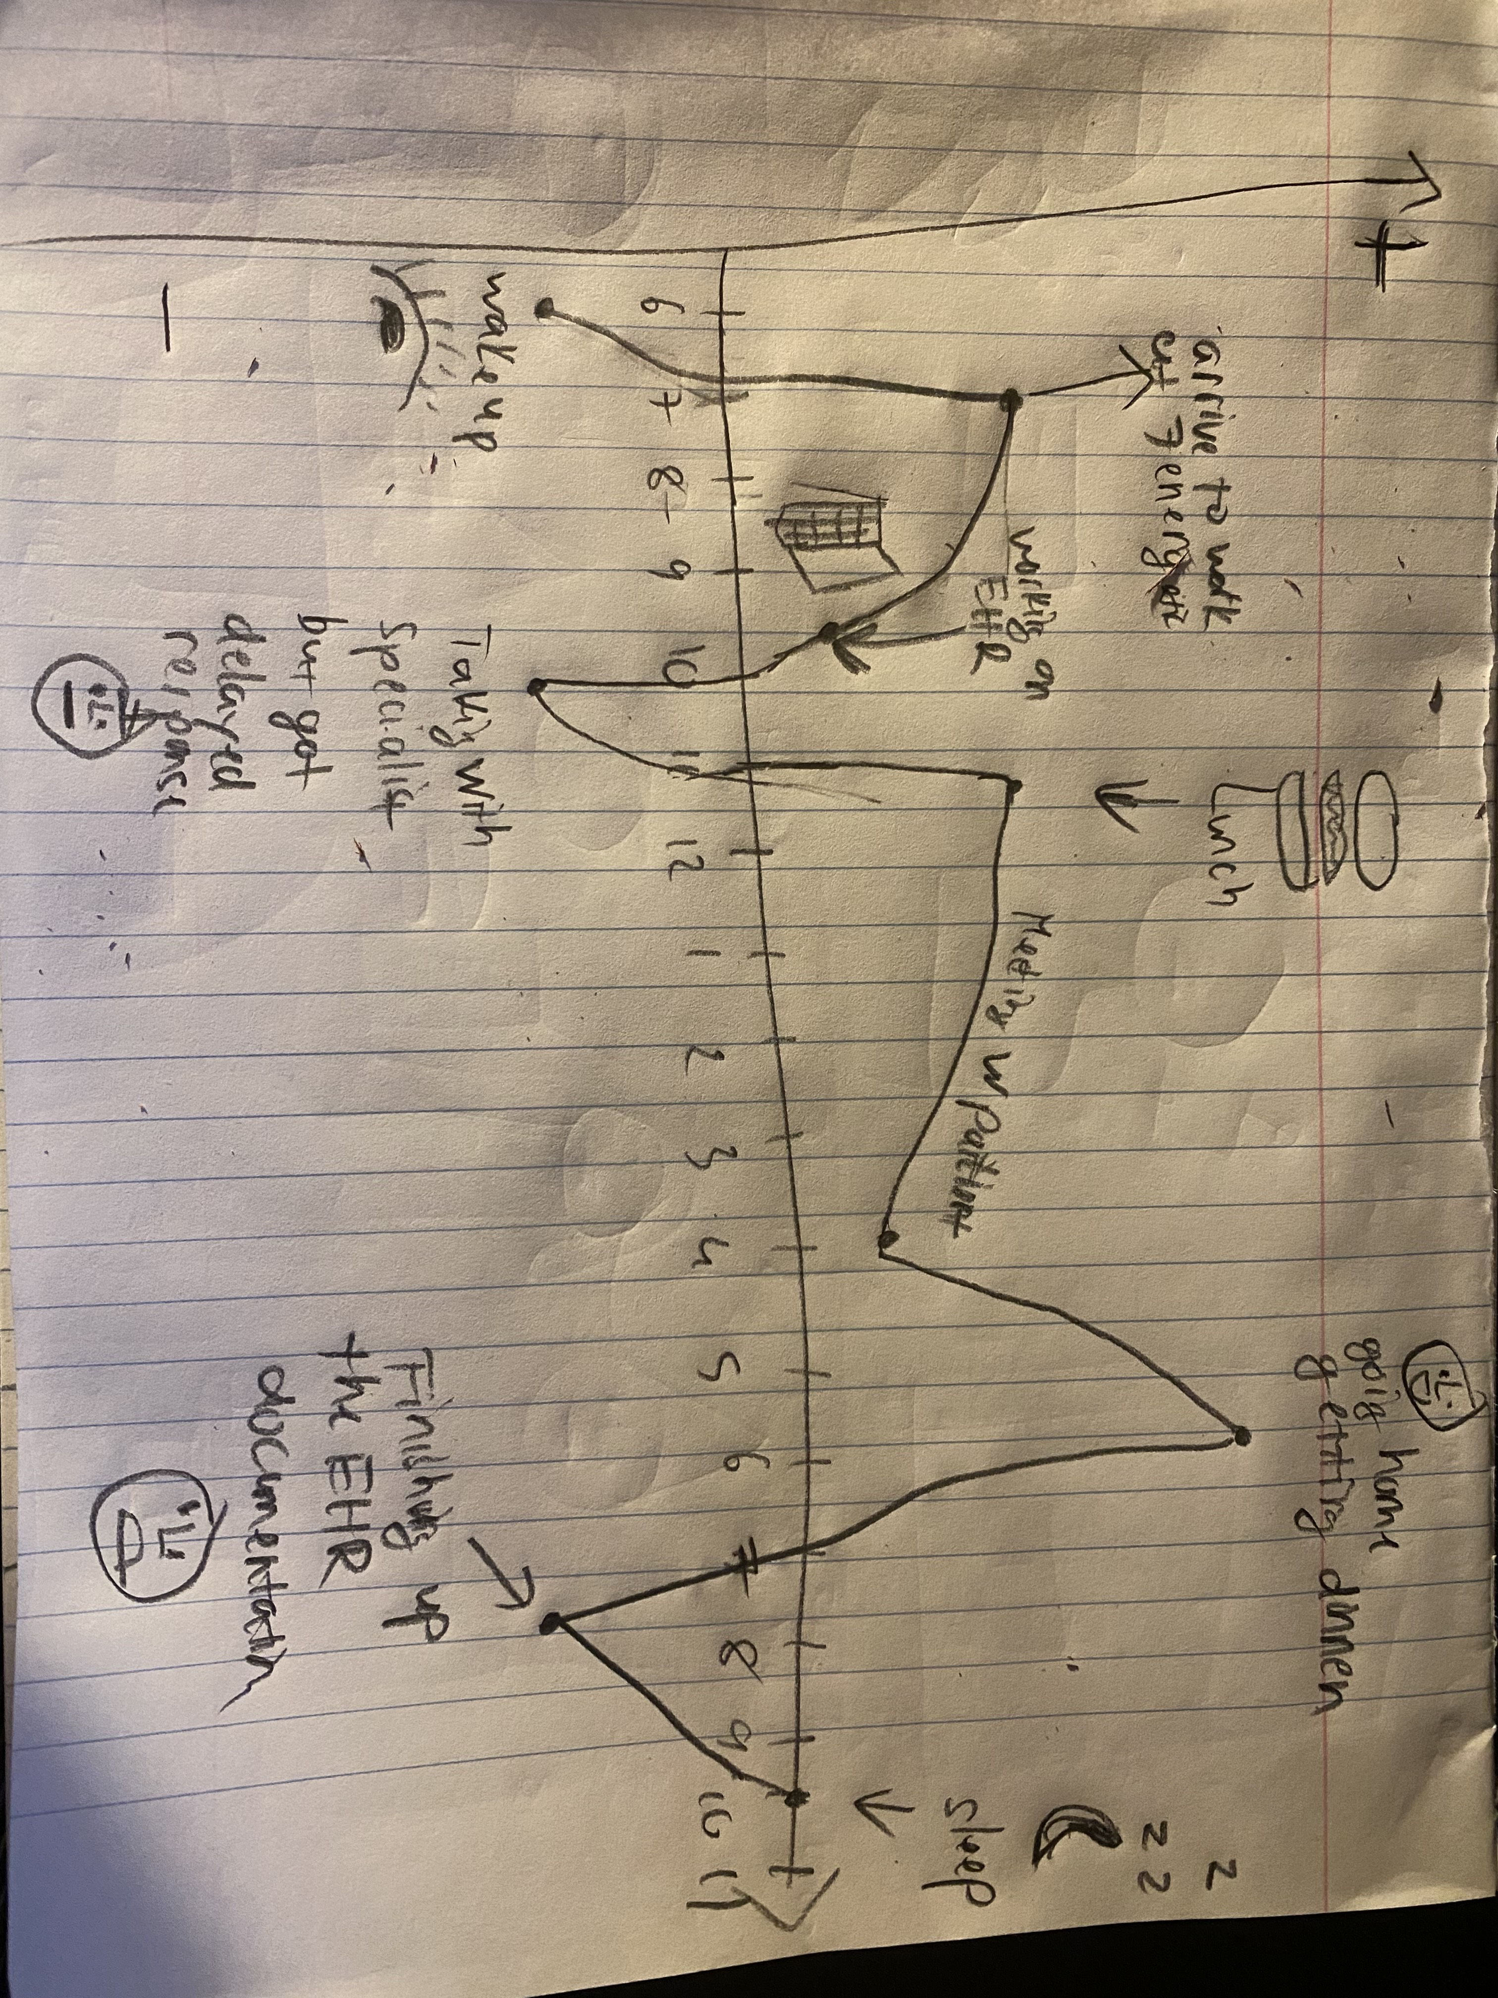
Interview with Henry

Slide 6
Define

Slide 7
PoV MadLibs 1 and 2
MadLib 1
[Henry] needs [an IoT retail solution for her work/life balance] because [he is always feeling tired and have to work outside of working time which is at home to finish the EHR documentation in order to help the patient.]
MadLib 2
[Henry] needs [an IoT retail solution for her job in the medical office] because [his medical office’s patient should be getting the best services with appropriate treatment, procedures and diagnosis in a reasonable amount of time]

Slide 8
Ideate

Slide 9
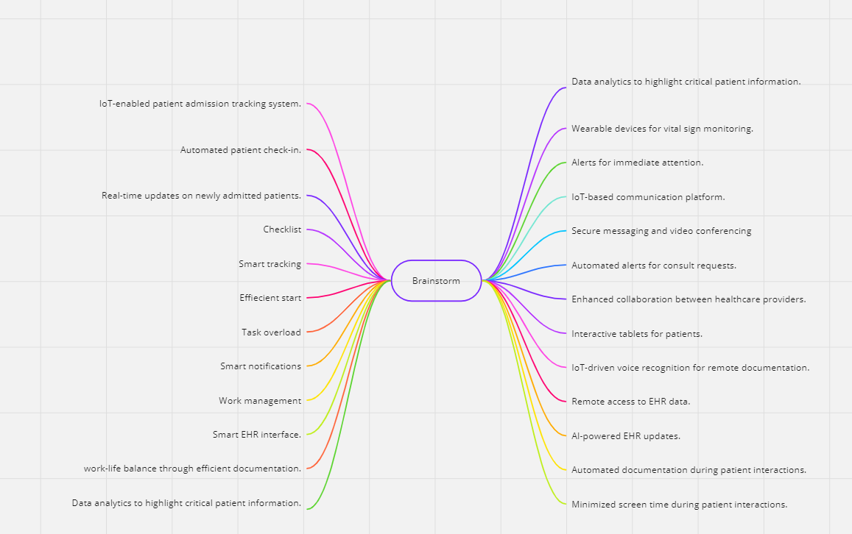
Brainstorm

Slide 10
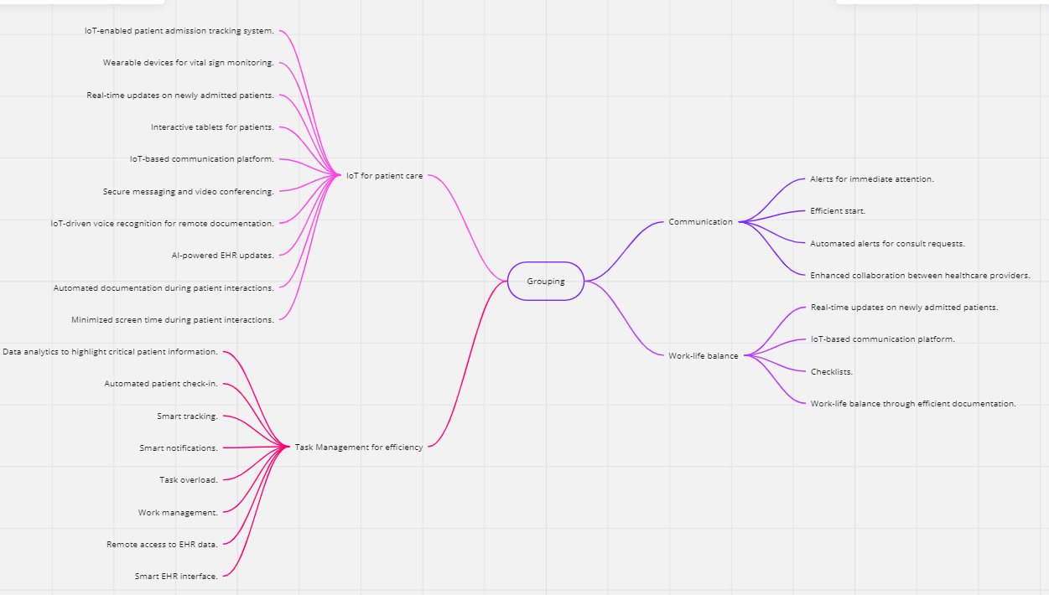
Group

Slide 11
From Divergent to Convergent
As I listed in my brainstorm, there are 4 groupings of ideas: IoT devices that benefits patient care, task management for efficiency, communication and work-life balance.
Notice the device cluster as primary. We will prototype a device that capable of obtain and distribute information's quickly to different devices.
The ideas around apps that make Henry ’s work life easier as secondary, but possible “front ends” for the Smart IoT Badge that will be helping him with accessibility to the patient information. This would be the basis for our 3-screen paper mobile-phone prototype.
Smart IoT Badge can include a touchscreen that capable of voice recording and integrates with the hospital’s communication system to be notified with emergency and EHR systems. Able to display patient information on the screen to review, providing quick access to patient data, vital signs and treatment plans. Capable of link to other devices such as phone, tablet, computer, laptop and receiving automated alerts and notifications for consults request, critical patient updates and support task organizations.
This device can be similar to a Smartwatch or a Smartphone but only used in the Hospital.
https://www.vocera.com/product/smartphones

Slide 12
Prototype

Slide 13
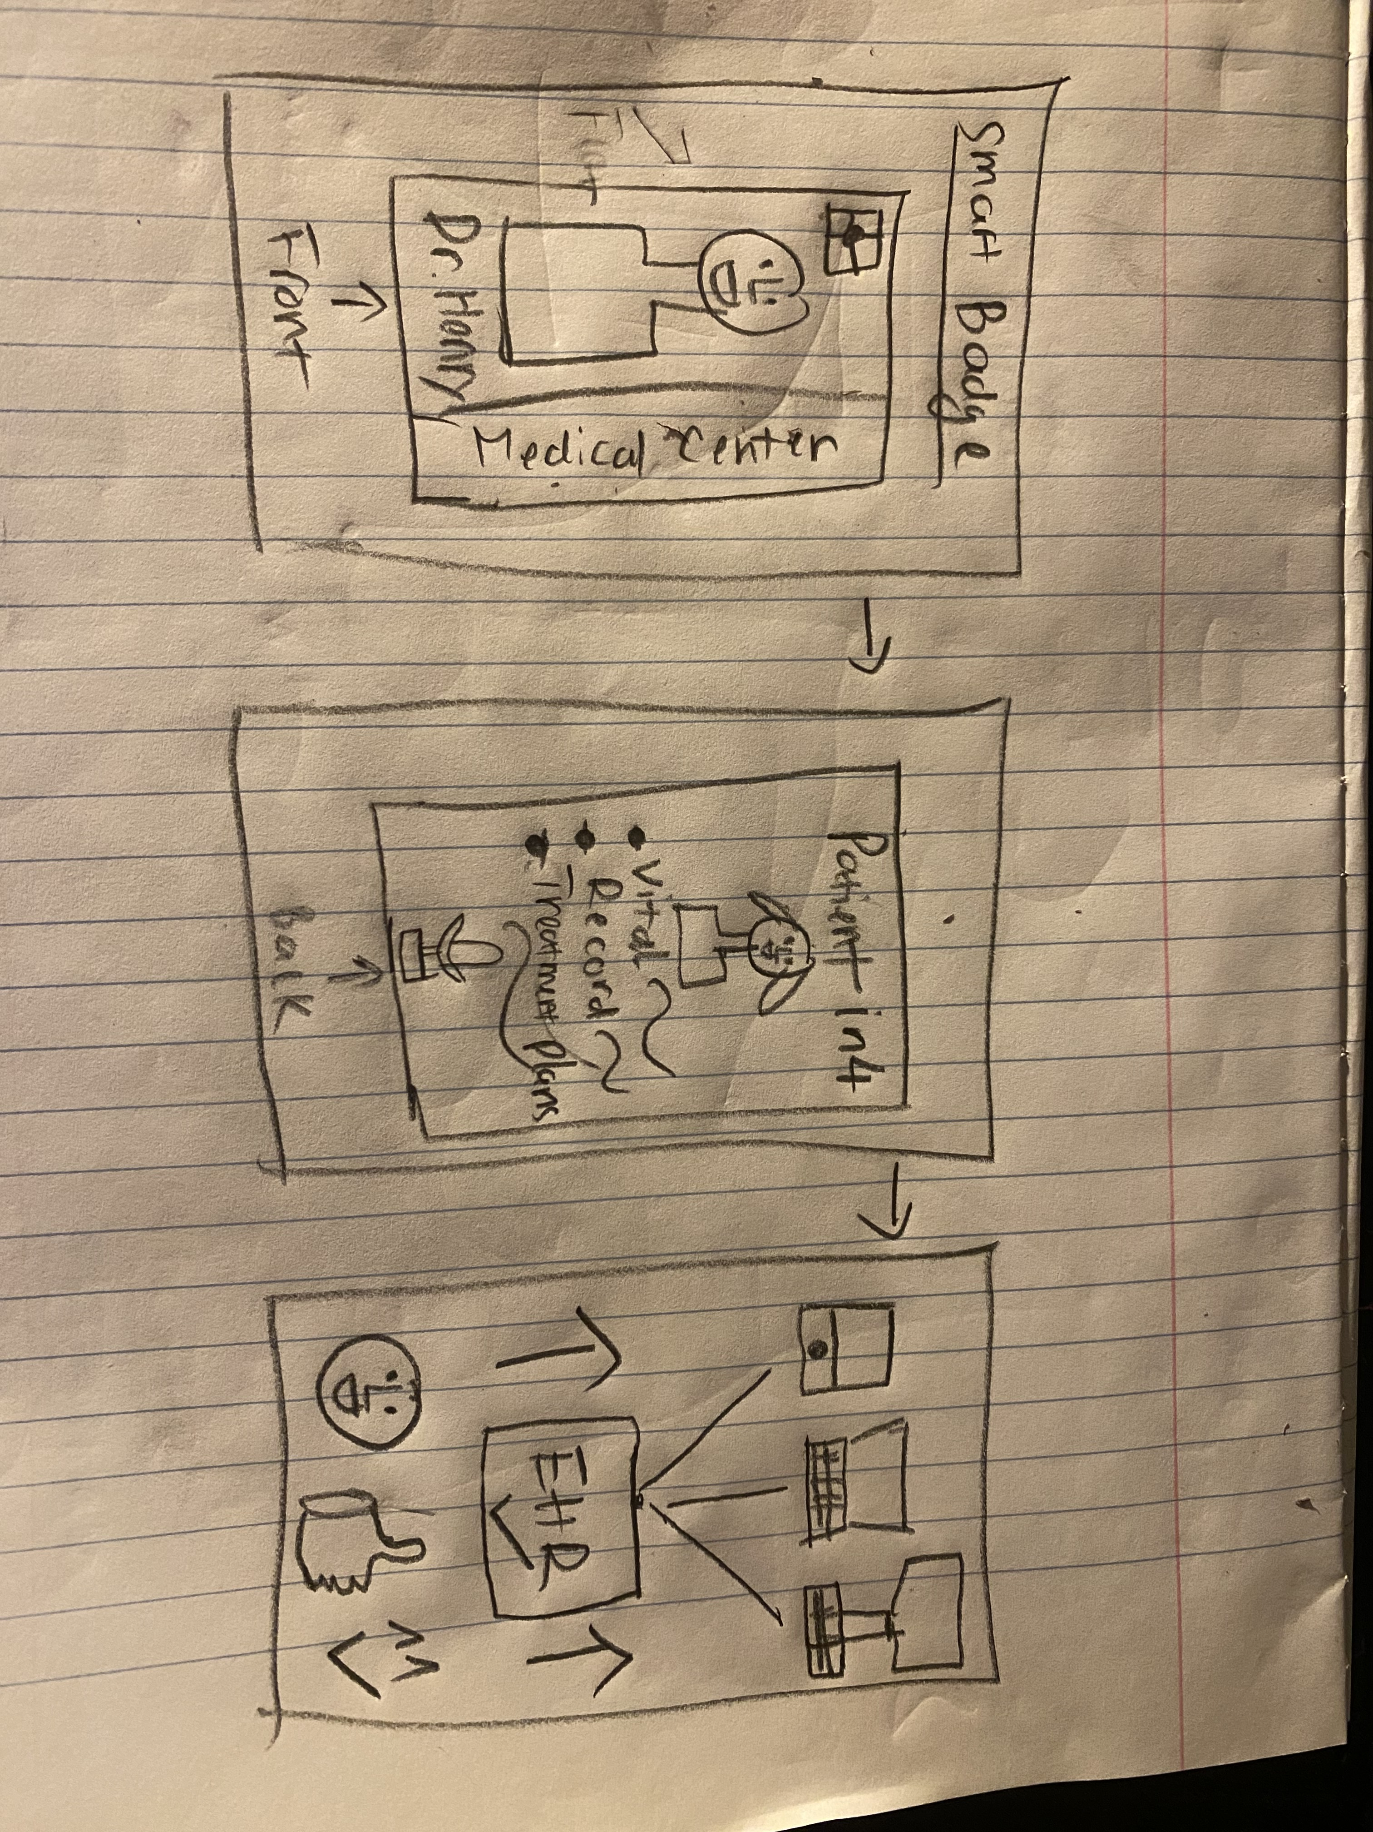
Frontend Sketch

Slide 14
Frontend Sketch

Slide 15
Frontend Sketch

Slide 16
Test/Reflect/Plan for Next Iteration

Slide 17
Test and Reflect
I would apply to test my prototype on a local hospital where I can get the permission. I would first use my phone first to create an app to collect and gather all data together, sorted it out and connect it with the notification system within the hospital. Then my next step would be creating a new device that can attach with the badge.
There will a large amount of qualitative and quantitative user data, patient data, hospital data to be collected for this prototype.
I would like to learn that the connections between the hospital data center, with the devices and my device to be linked together and perceive how effective and beneficial it can be to Hospitalist like Henry Chambers.
It is very interesting to me to learn about how IoT can be very useful and make a whole change to make patient’s life become way better.

